Slide 1


SPTechCon: Display it the way you Want! Display Templates to the Rescue.
Presented by Peter Allen

Slide 2

Meeting Agenda
Who am I?
The Display Template
Office Fabric UI
Examples

Slide 3

Who am I?

Slide 4

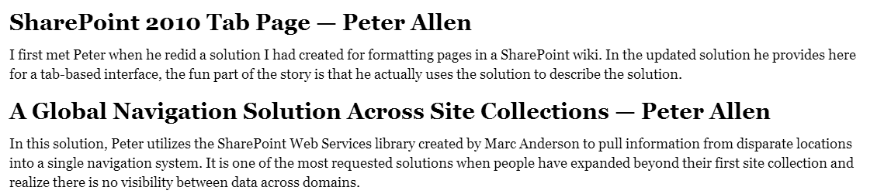
Who am I?
Name: Peter Allen
Location: Sacramento
Experience: Working with SharePoint for over 10 years from 2003 to 2016 / Office 365
Written Chapters for:
SharePoint 2010 at Work: Tricks, Traps, and Bold Opinions

Slide 5
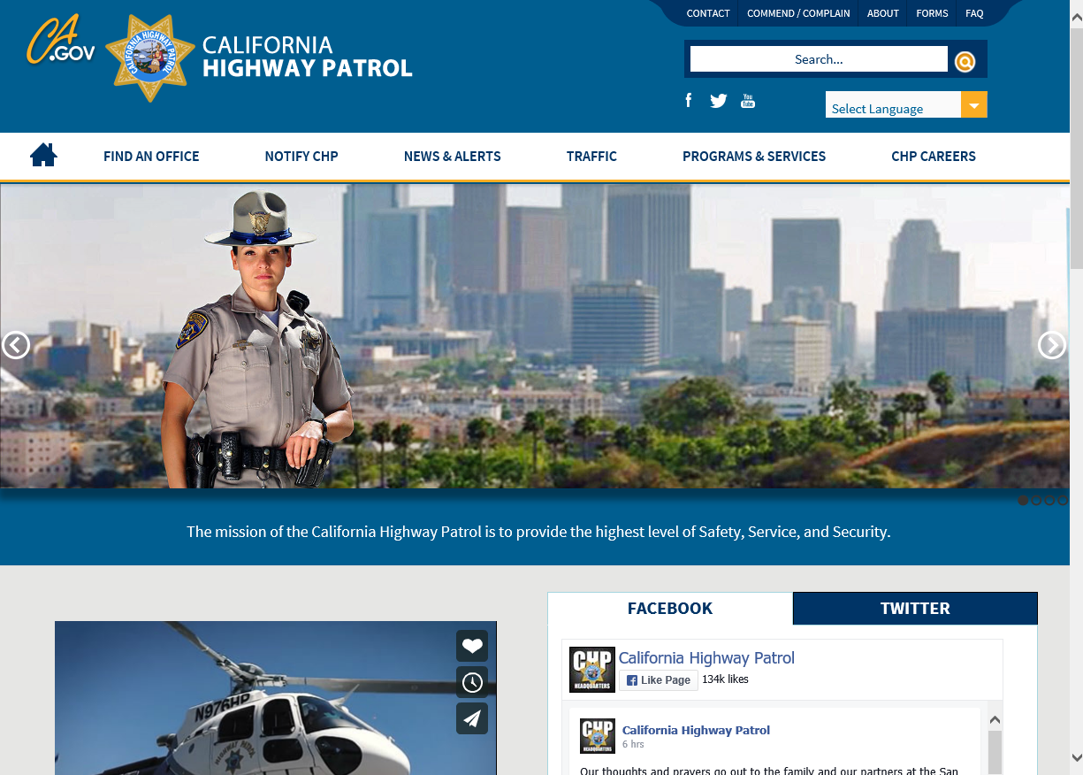
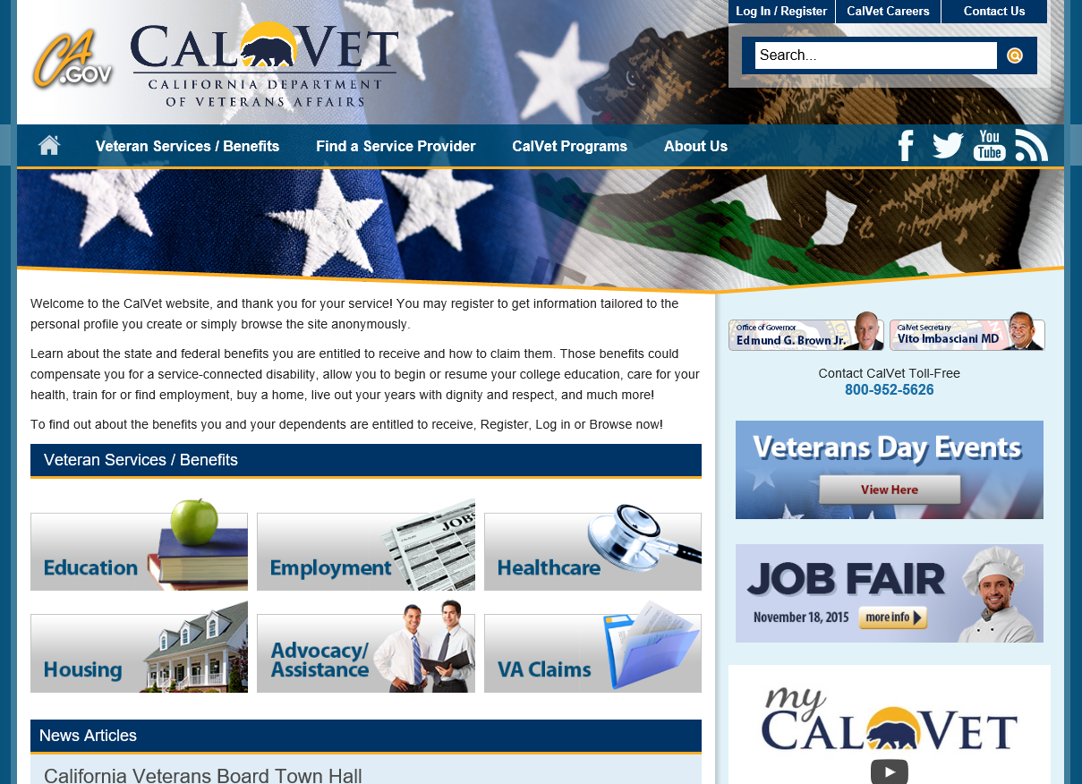
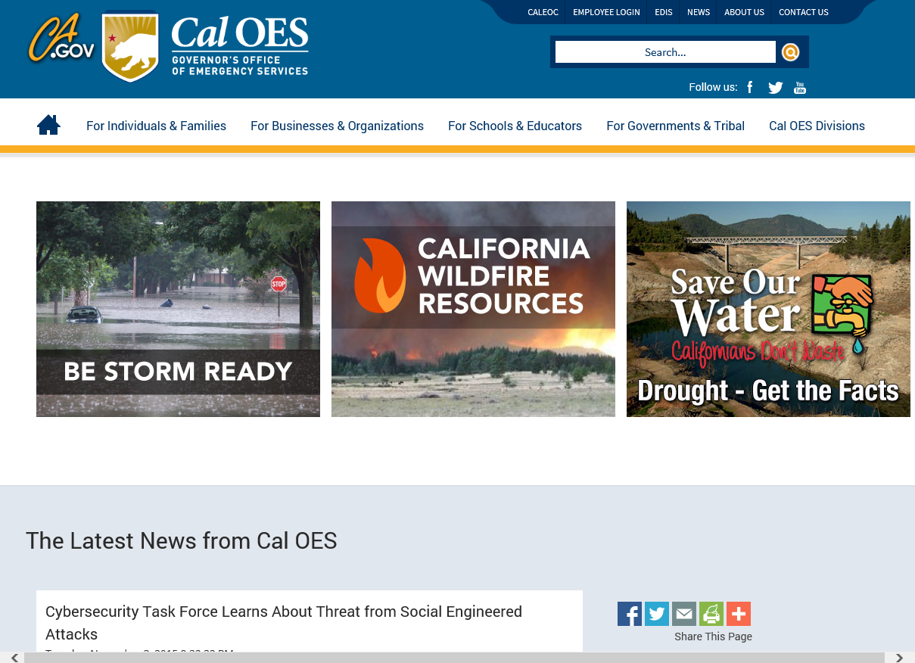
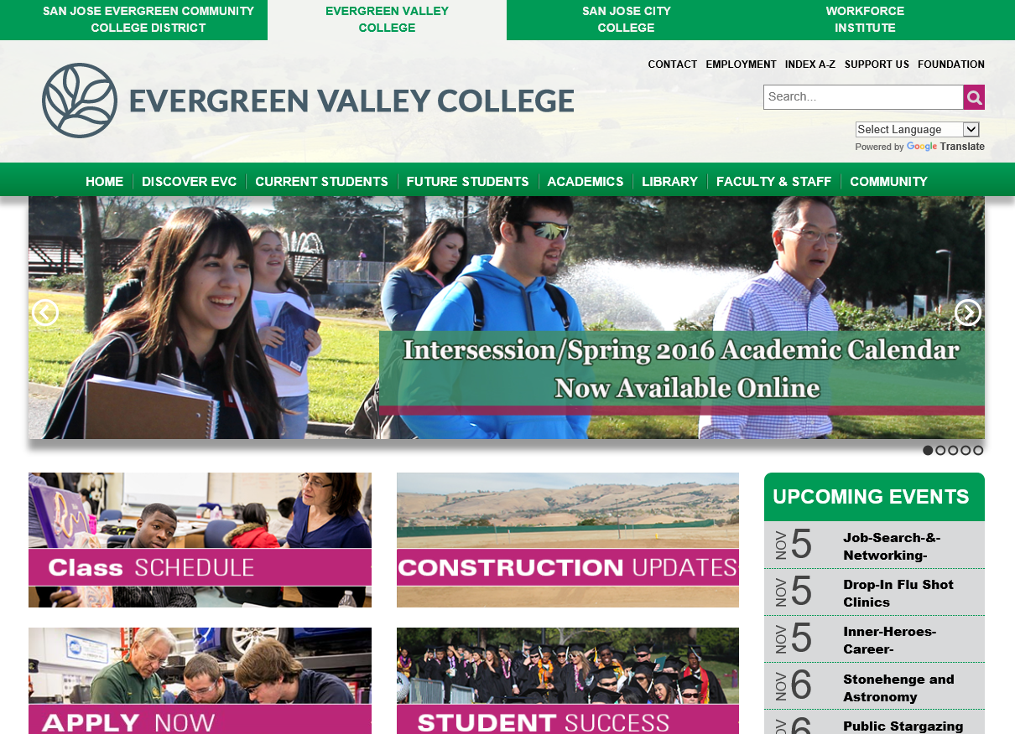
Public Web Sites – SP 2013

Slide 6
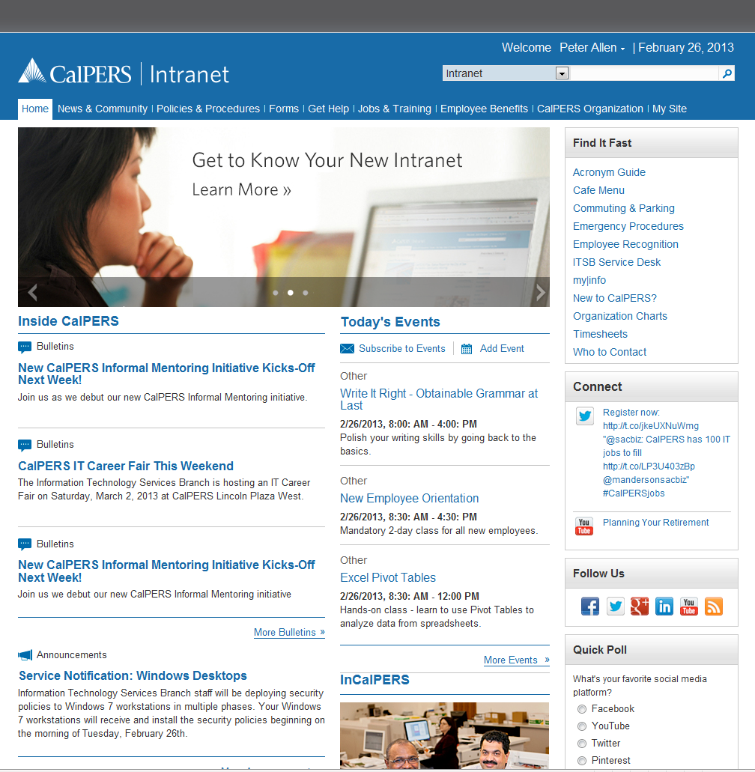
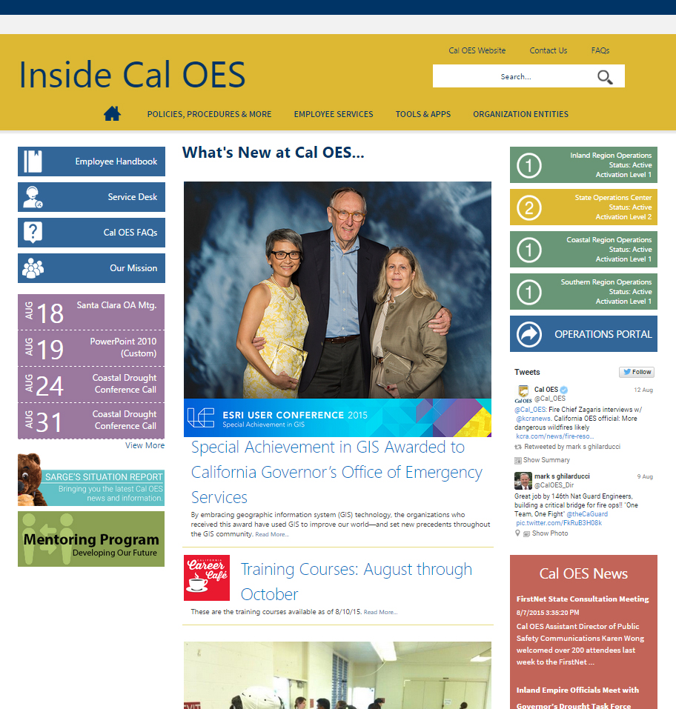
Intranets - SP 2010 / 2013

Slide 7

What Are Display Templates?

Slide 8
Display Templates
Gained prominence with the introduction SharePoint 2013
Are a major part of the Content Search Web Part (CSWP)
Allows you to display content in other ways than just a list / table
Allows you to use HTML, CSS, and other frameworks to design and add functionality
Are reusable with other lists / libraries / content types
Provides a consistent look and feel to content

Slide 9
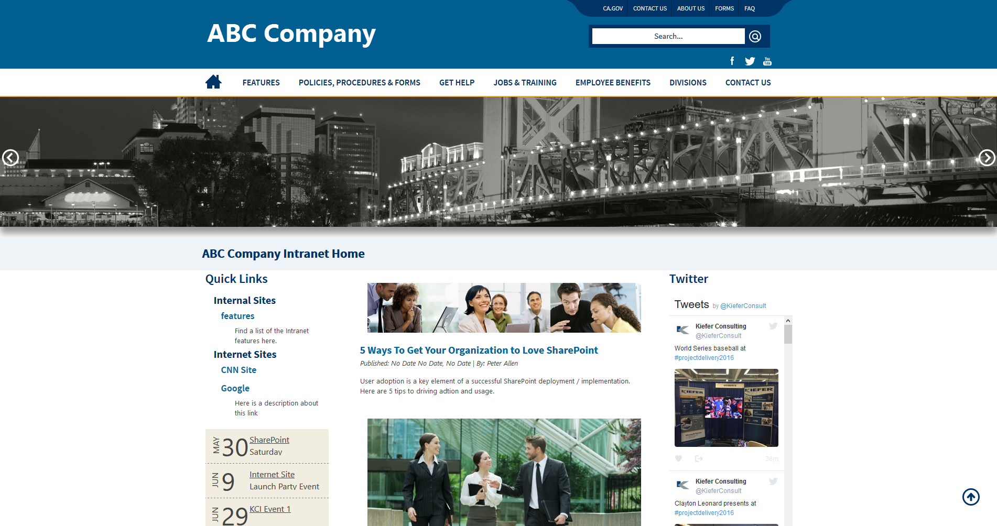
Where is the Display Template?

Slide 10
Display Templates
Great to use on:
Publishing Sites
Public Facing Web Sites
Any where content is going to be rolled up
Any where you want to display list / library data but not in a standard list / table format

Slide 11
Display Templates
Demo
CalHR - http://calhr.ca.gov/state-hr-professionals/Pages/main.aspx
Sac Metro AQMD
http://www.airquality.org/Businesses/Incentive-Programs
http://www.airquality.org/residents/incentive-programs/agricultural-construction-equipment-replacement
CalOES
http://caloes.ca.gov/Cal-OES-Divisions/About-Cal-OES/FAQ
CHP
https://www.chp.ca.gov/home/forms
CalVet
https://www.calvet.ca.gov/veteran-services-benefits/education

Slide 12

What is the anatomy of a Display Template?

Slide 13
Display Templates
DISPLAY TEMPLATES
They provide a structure to the way we can display our content.
They provide layers to work with when displaying content.
There is an outer layer (CONTROL)
There is an inner layer (ITEM)
80% - 90% of work is down in the ITEM Display Template
Item 1
CONTROL
Item 2
ITEM
Item 3

Slide 14
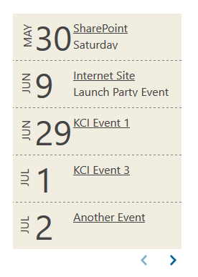
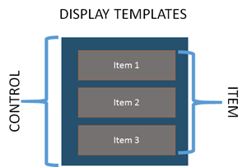
Display Templates
Control Display Template
Used to wrap the design
Affects the beginning and end
like HTML elements (<div>content</div>)
Where to include pagination
Item Display Templates
Used for each item in the results
Will apply the same formatting to each item
Together they form the sandwich for displaying the results of a CSWP

Slide 15
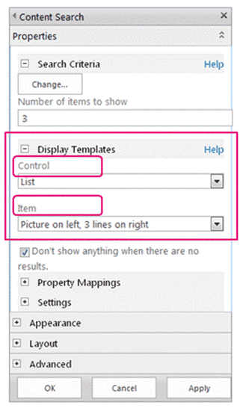
Display Template
When you edit the CSWP you will have the option to Choose:
Control Display Template
Item Display Template

Slide 16
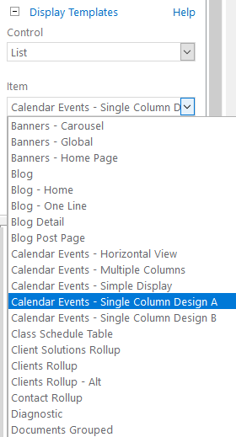
Display Template
The main parts of Display Template
Title tag
This is the title of the Display template that you will see in the drop down
Header properties
This where you will define the Managed Properties to use as data points to display
Script block
Here you can add any additional scripts needed for the display to work. Like JS Frameworks.
DIV block
This is where you will use JS and HTML to create the final look and feel

Slide 17
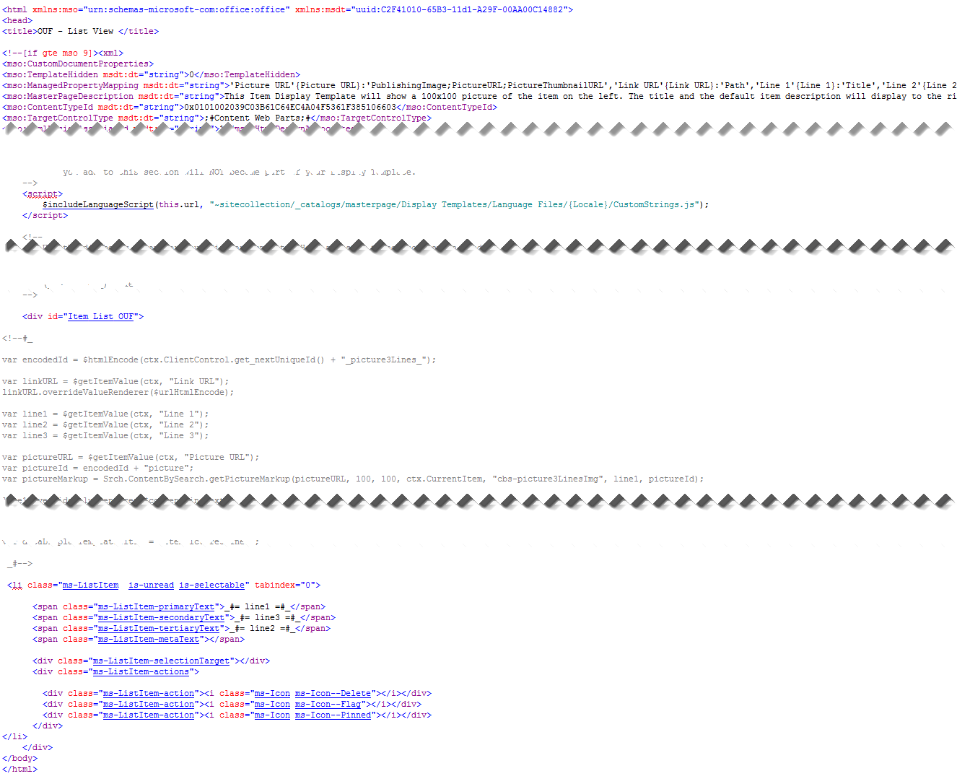
Display Template
Title tag
Header properties
Script block
DIV block

Slide 18
Office UI Fabric

Slide 19
Office UI Fabric
Microsoft is providing a unified UI that will be using across the Office 365 environment.
Microsoft is also making them open source
Office UI Fabric is designed to be used in client side scripting
In this demo we will retrofit it to work with Display Template

Slide 20
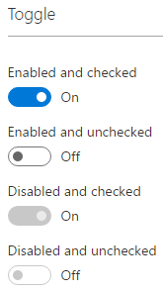
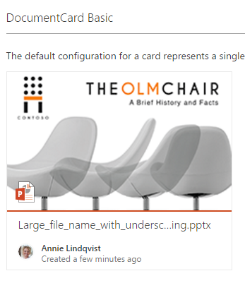
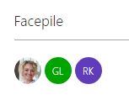
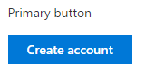
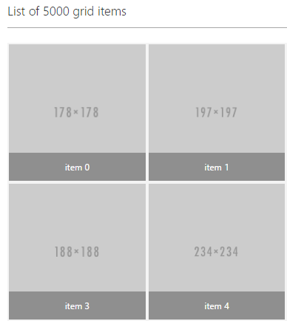
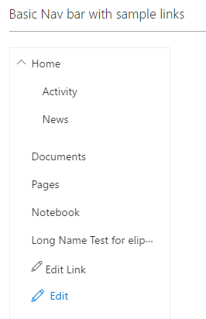
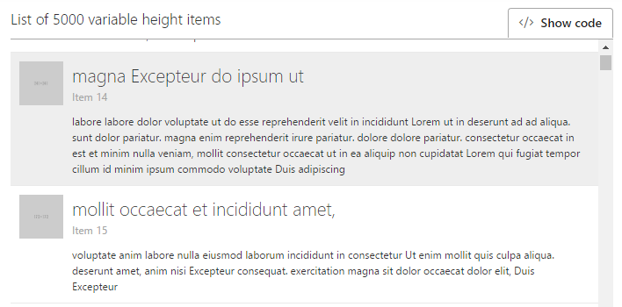
Office UI Fabric

Slide 21
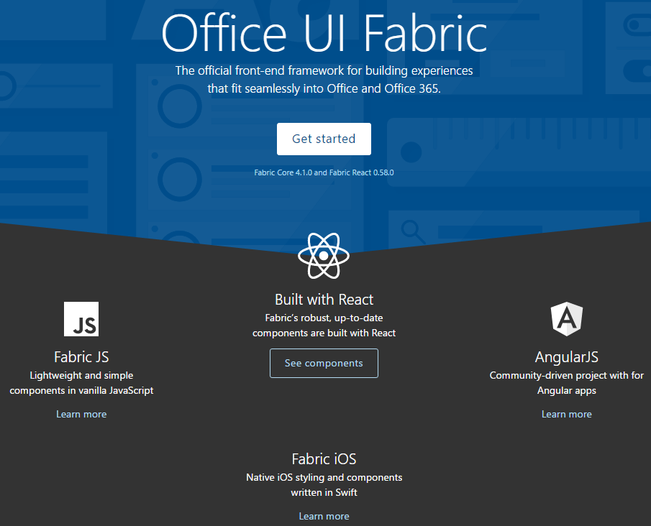
Office UI Fabric
https://dev.office.com/fabric

Slide 22
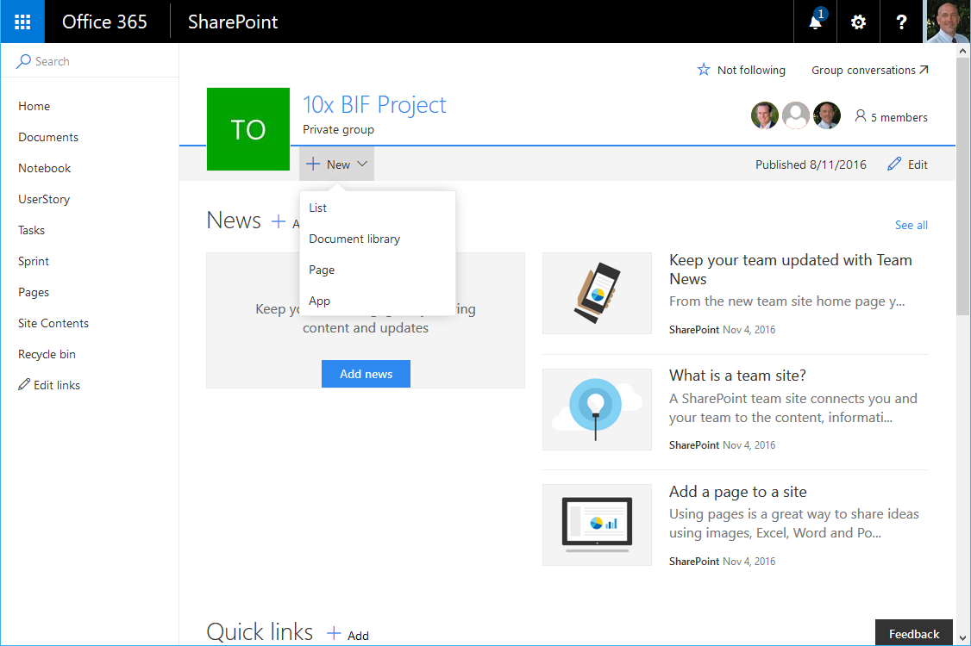
Office UI Fabric

Slide 23
Office UI Fabric
Review the JS site for the Office UI Fabric
https://github.com/OfficeDev/office-ui-fabric-js

Slide 24
Demo Display Template

Slide 25
Display Template Demo
Review the attributes of a display template
Create a new Display Template
Use the Office UI Fabric
https://github.com/OfficeDev/office-ui-fabric-js/blob/master/ghdocs/COMPONENTSLIST.md
Review Other Display Templates
Document Grouping
Events
FAQs
etc.

Slide 26
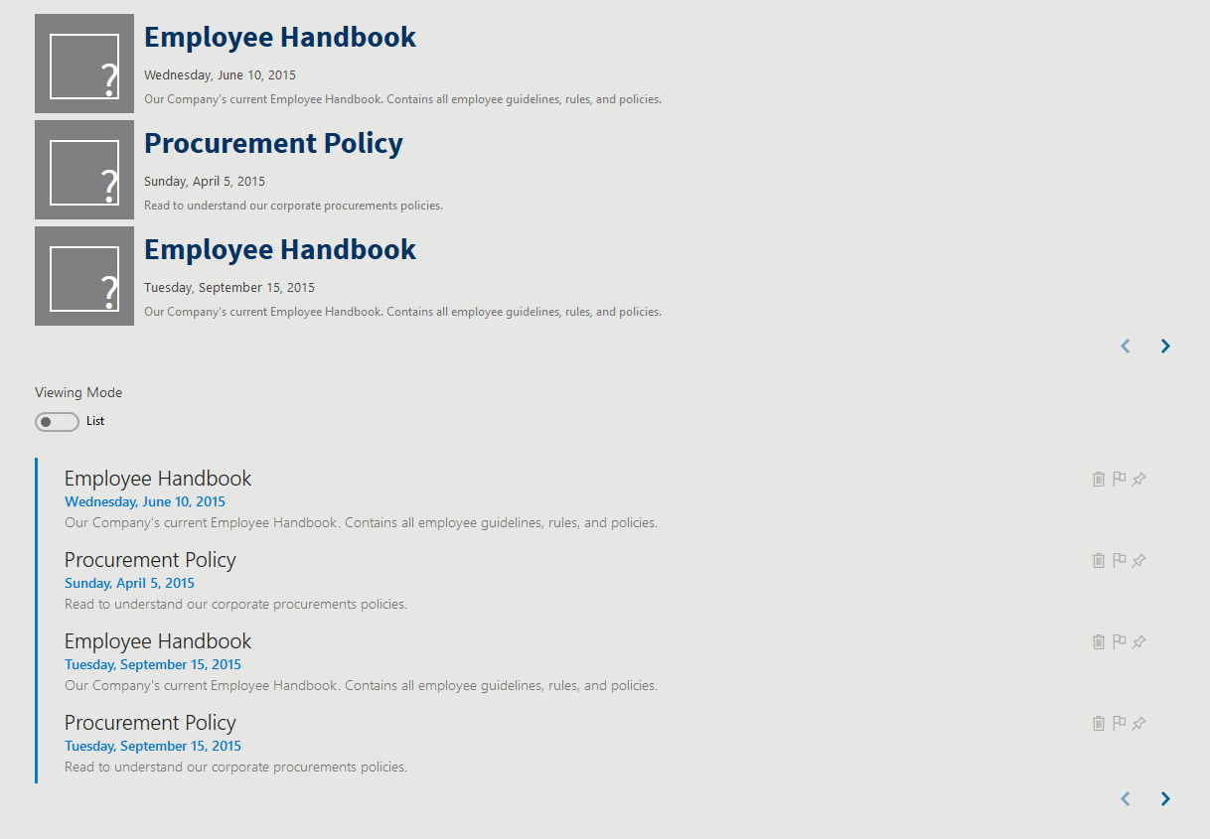
Display Demo Result

Slide 27
Code Snippets
Control
$includeCSS(this.url, "https://static2.sharepointonline.com/files/fabric/office-ui-fabric-js/1.2.0/css/fabric.min.css");
$includeCSS(this.url, "https://static2.sharepointonline.com/files/fabric/office-ui-fabric-js/1.2.0/css/fabric.components.min.css");
$includeScript(this.url, "https://static2.sharepointonline.com/files/fabric/office-ui-fabric-js/1.2.0/js/fabric.min.js");
<ul class="ms-List ms-rtestate-field">
<div class="ms-Toggle ">
<span class="ms-Toggle-description">Viewing Mode</span>
<input type="checkbox" id="demo-toggle-3" class="ms-Toggle-input" />
<label for="demo-toggle-3" class="ms-Toggle-field" tabindex="0" >
<span class="ms-Label ms-Label--off">List</span>
<span class="ms-Label ms-Label--on">Grid</span>
</label>
</div>

Slide 28
Code Snippets
Control
AddPostRenderCallback(ctx, function(){
var ToggleElements = document.querySelectorAll(".ms-Toggle");
for(var i = 0; i < ToggleElements.length; i++) {
new fabric['Toggle'](ToggleElements[i]);
}
$('.ms-Toggle-field').click(function() {
$('.ms-List').toggleClass( "kci-grid" );
});
});

Slide 29
Code Snippets
Item
<li class="ms-ListItem is-unread is-selectable" tabindex="0">
<span class="ms-ListItem-primaryText">_#= line1 =#_</span>
<span class="ms-ListItem-secondaryText">_#= line3 =#_</span>
<span class="ms-ListItem-tertiaryText">_#= line2 =#_</span>
<span class="ms-ListItem-metaText"></span>
<div class="ms-ListItem-selectionTarget"></div>
<div class="ms-ListItem-actions">
<div class="ms-ListItem-action"><i class="ms-Icon ms-Icon--Delete"></i></div>
<div class="ms-ListItem-action"><i class="ms-Icon ms-Icon--Flag"></i></div>
<div class="ms-ListItem-action"><i class="ms-Icon ms-Icon--Pinned"></i></div>
</div>
</li>

Slide 30
Code Snippets
Item
var itemIndex = ctx.CurrentItemIdx;
var itemCount = ctx.CurrentItemIdx + 1;
var rowCount = ctx.CurrentGroup.ResultRows.length;

Slide 31


Questions & Answers

Slide 32
Thank You

